Slide 1
SQL Advent Calendar 2024
https://www.sqlcalendar.com/app/advent-calendar

Slide 2
About SQL Advent Calendar 2024
This document contains my solutions to the SQL Advent Calendar Challenge, created by Dawn Choo. The challenge features 24 SQL problems, designed to be solved daily from December 1st to Christmas Eve, 2024.
Each solution is carefully crafted to demonstrate best practices in SQL problem-solving, with clear and concise explanations to ensure ease of understanding.

Slide 3
Day 1

Slide 4
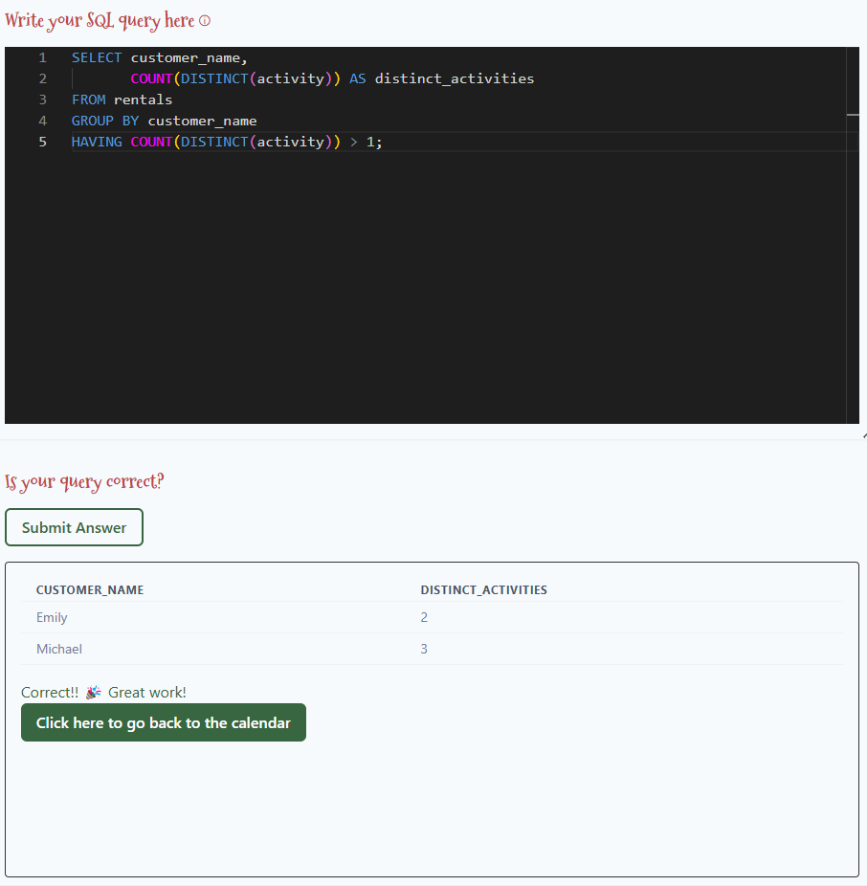
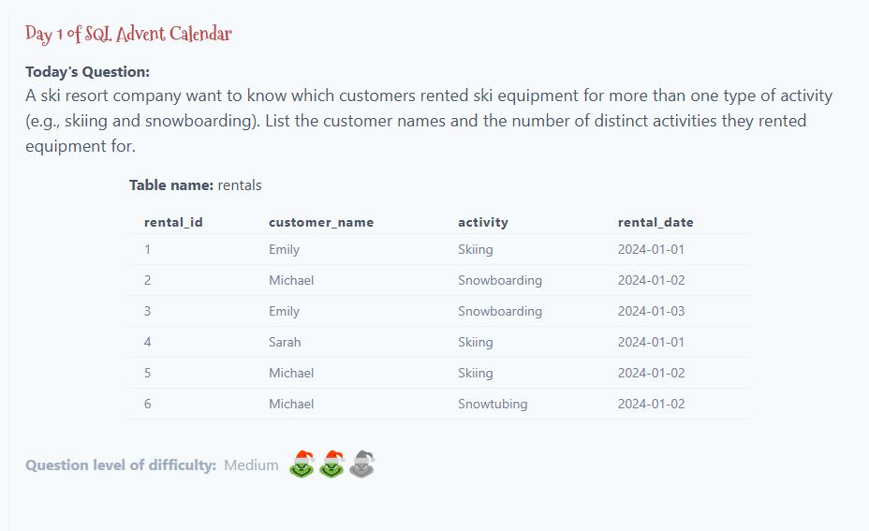

Slide 5
Solution:
SELECT customer_name,
COUNT(DISTINCT(activity)) AS distinct_activities
FROM rentals
GROUP BY customer_name
HAVING COUNT(DISTINCT(activity)) > 1;

Slide 6
Day 2

Slide 7
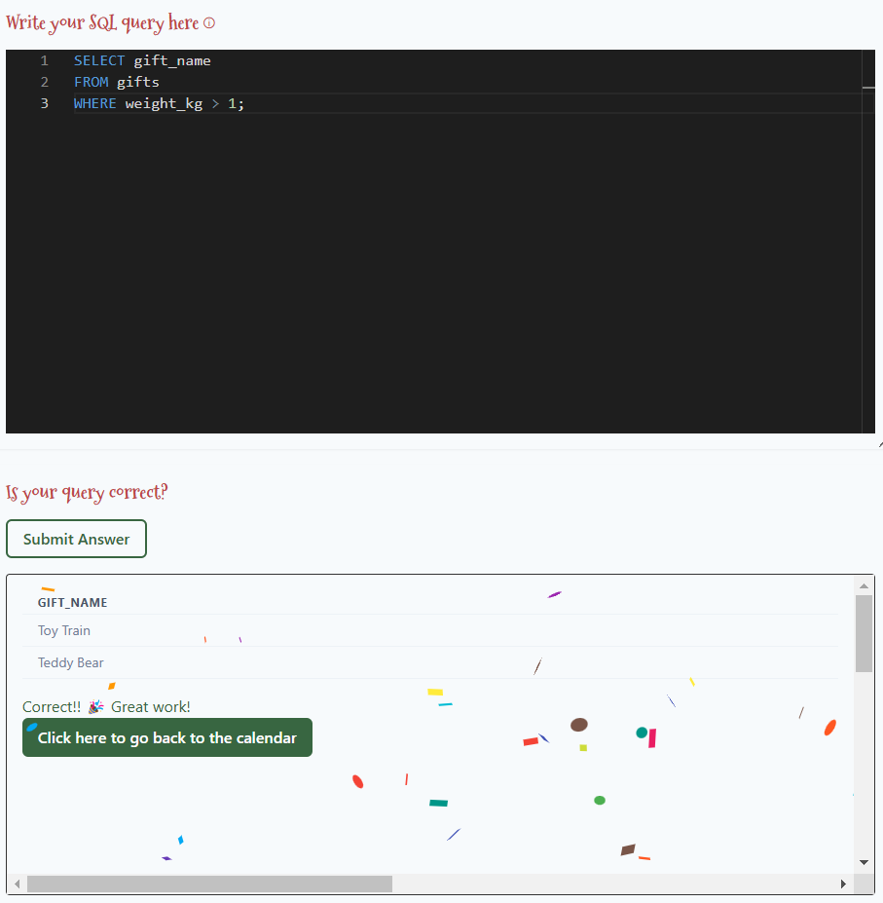
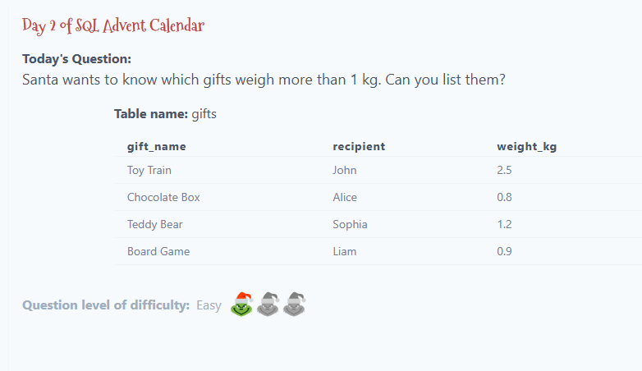

Slide 8
Solution:
SELECT gift_name
FROM gifts
WHERE weight_kg > 1;

Slide 9
Day 3

Slide 10
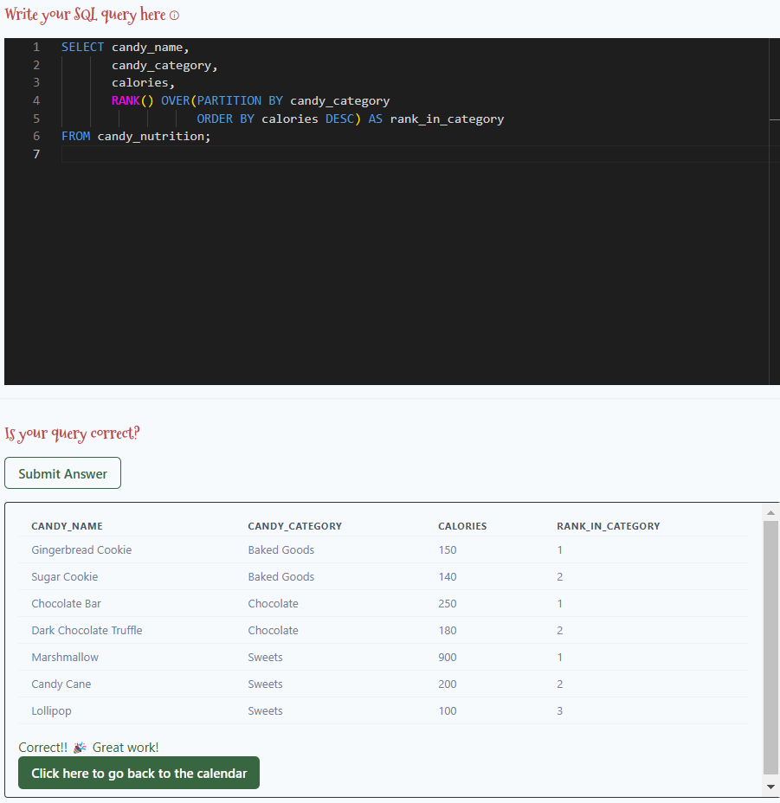
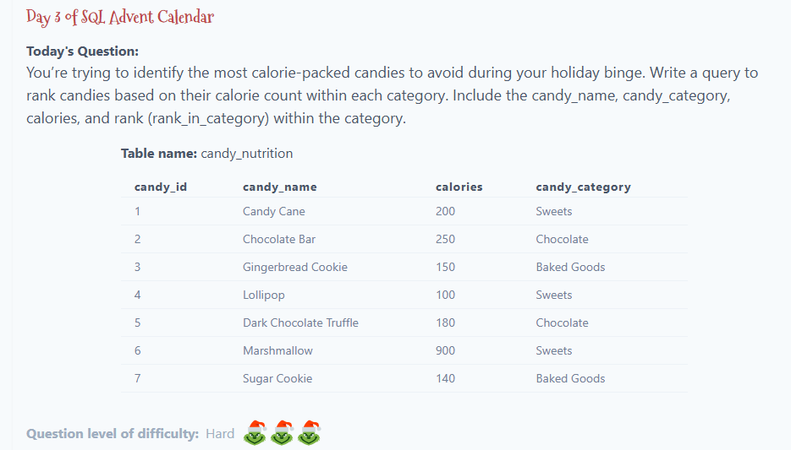

Slide 11
Solution:
SELECT candy_name,
candy_category,
calories,
RANK() OVER(PARTITION BY candy_category
ORDER BY calories DESC) AS rank_in_category
FROM candy_nutrition;

Slide 12
Day 4

Slide 13
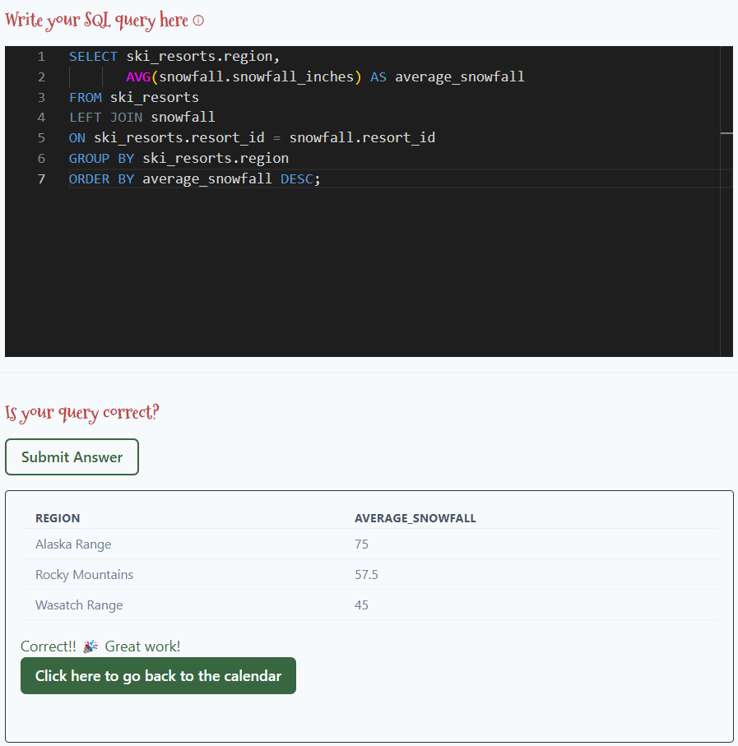
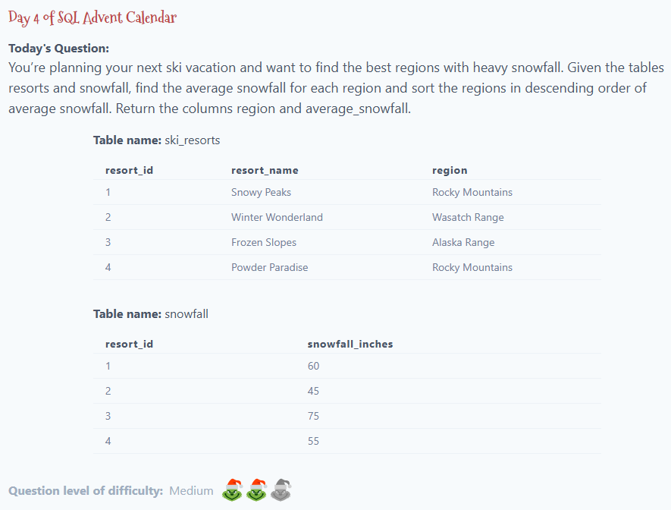

Slide 14
Solution:
SELECT ski_resorts.region,
AVG(snowfall.snowfall_inches) AS average_snowfall
FROM ski_resorts
LEFT JOIN snowfall
ON ski_resorts.resort_id = snowfall.resort_id
GROUP BY ski_resorts.region
ORDER BY average_snowfall DESC;

Slide 15
Day 5

Slide 16
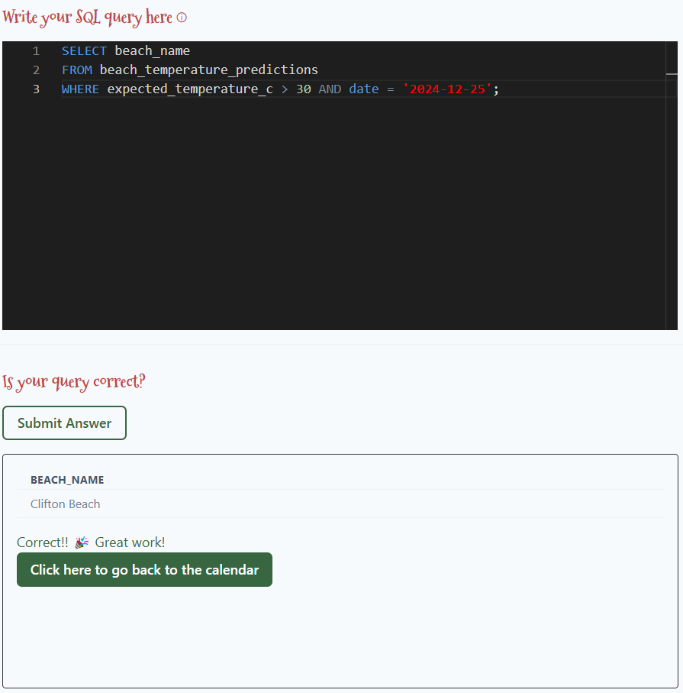
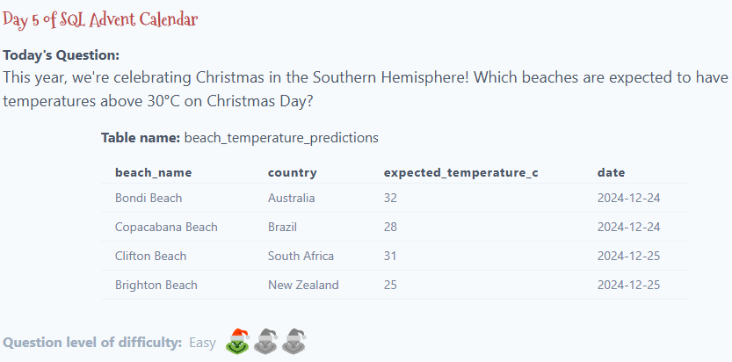

Slide 17
Solution:
SELECT beach_name
FROM beach_temperature_predictions
WHERE expected_temperature_c > 30 AND date = '2024-12-25';

Slide 18
Day 6

Slide 19
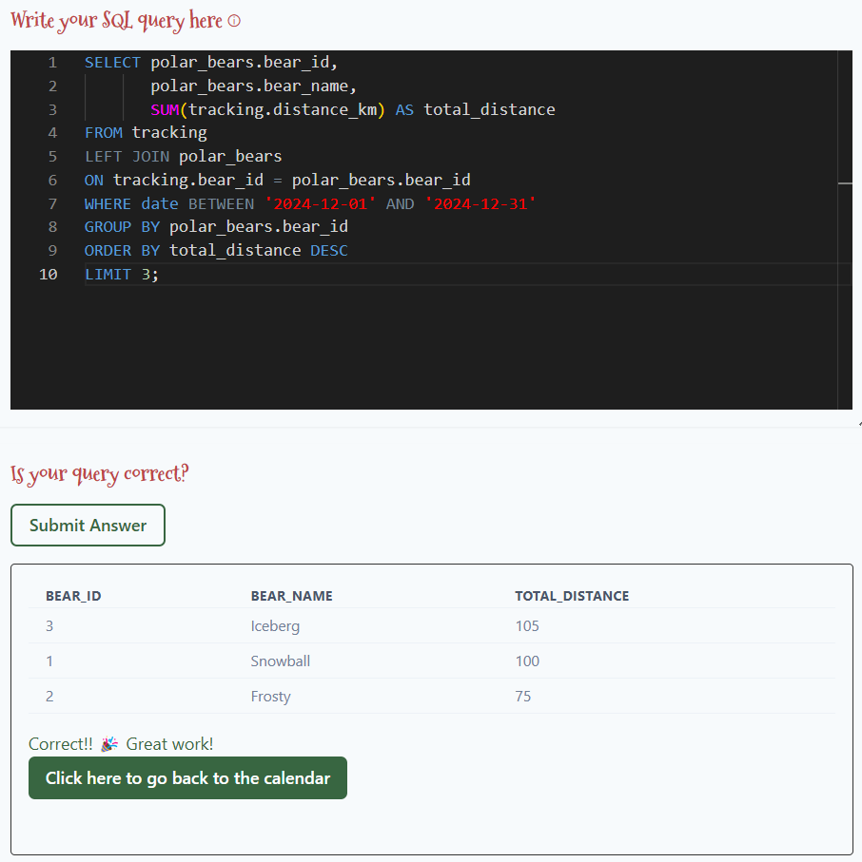
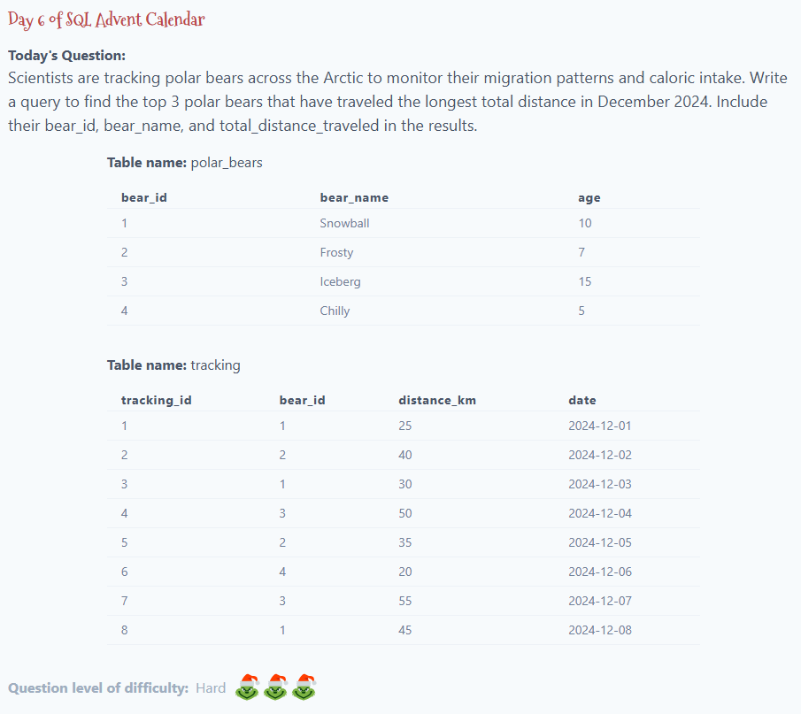

Slide 20
Solution:
SELECT polar_bears.bear_id,
polar_bears.bear_name,
SUM(tracking.distance_km) AS total_distance
FROM tracking
LEFT JOIN polar_bears
ON tracking.bear_id = polar_bears.bear_id
WHERE date BETWEEN '2024-12-01' AND '2024-12-31'
GROUP BY polar_bears.bear_id
ORDER BY total_distance DESC
LIMIT 3;

Slide 21
Day 7

Slide 22
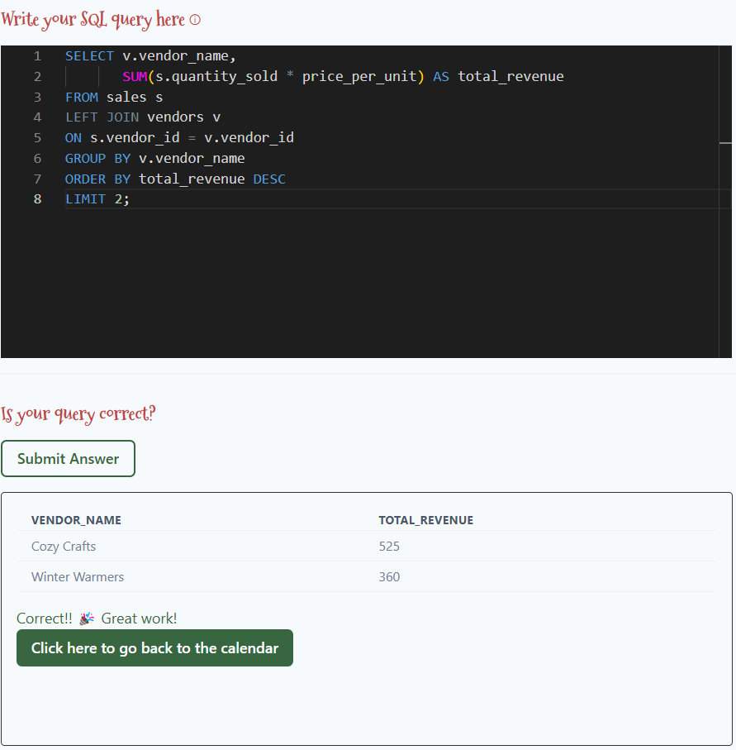
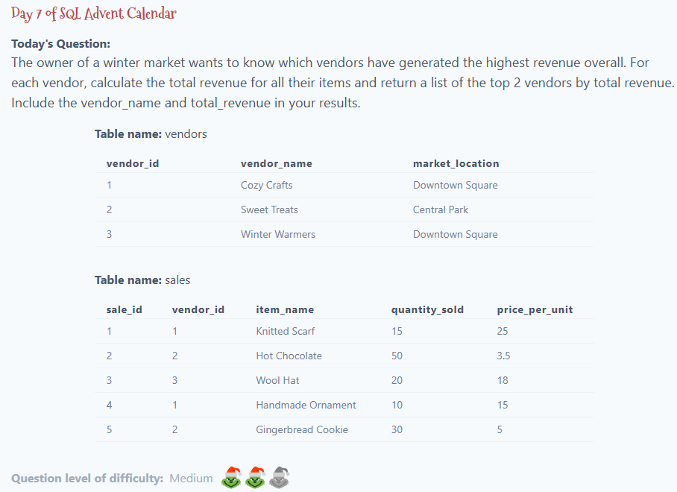

Slide 23
Solution:
SELECT v.vendor_name,
SUM(s.quantity_sold * price_per_unit) AS total_revenue
FROM sales s
LEFT JOIN vendors v
ON s.vendor_id = v.vendor_id
GROUP BY v.vendor_name
ORDER BY total_revenue DESC
LIMIT 2;

Slide 24
Day 8

Slide 25
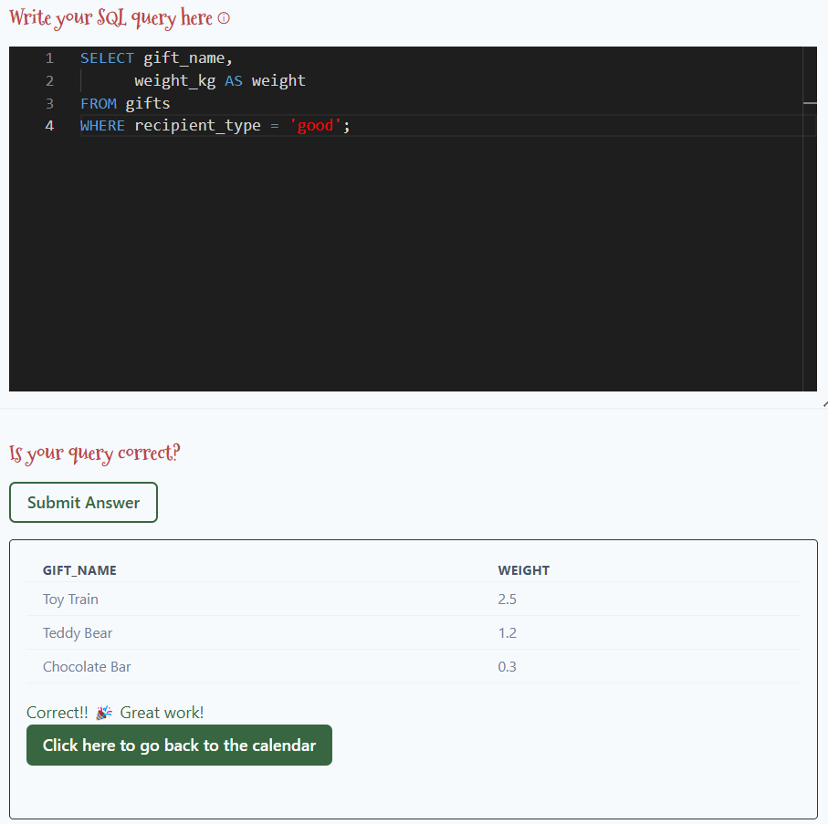
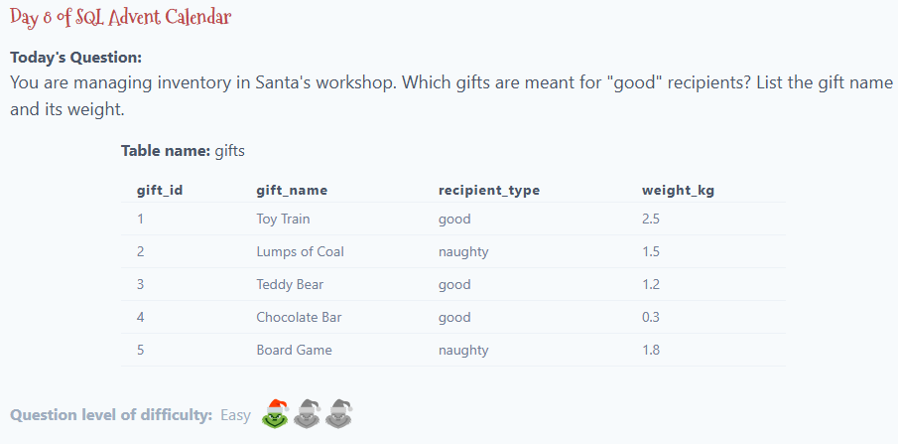

Slide 26
Solution:
SELECT gift_name,
weight_kg AS weight
FROM gifts
WHERE recipient_type = 'good';

Slide 27
Day 9

Slide 28
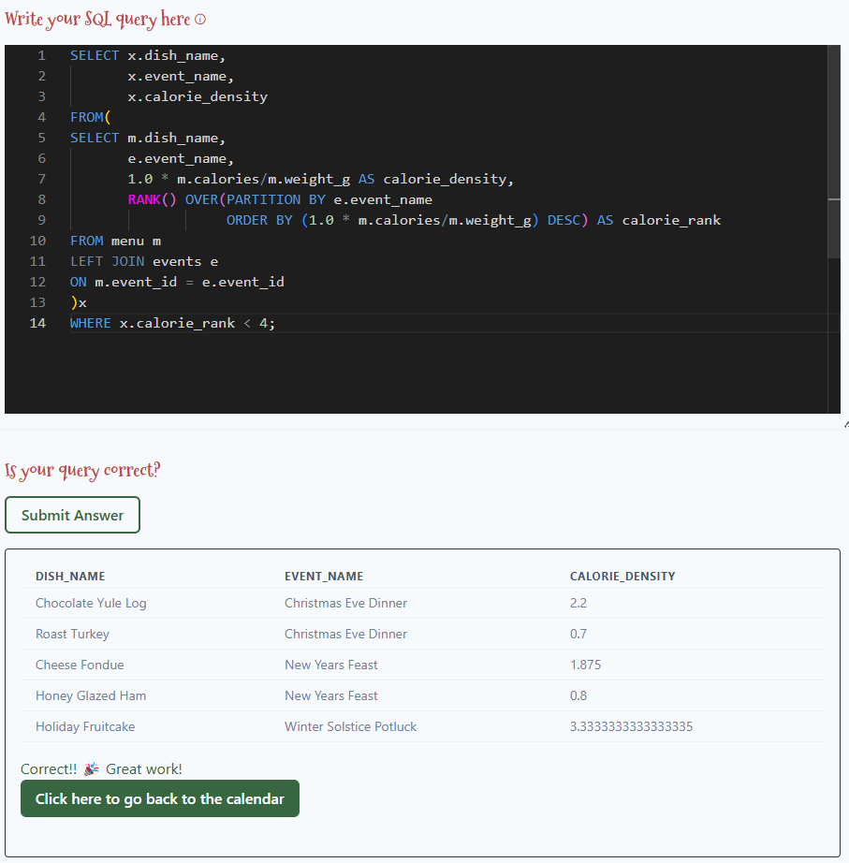
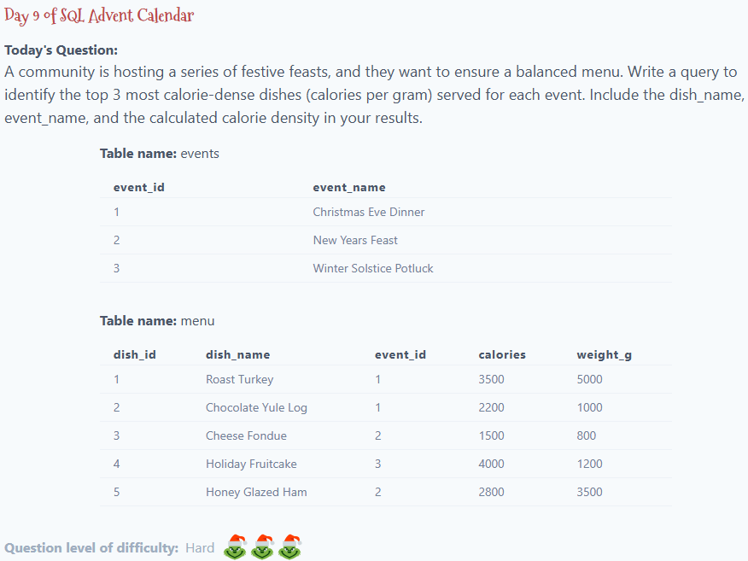

Slide 29
Solution:
SELECT x.dish_name,
x.event_name,
x.calorie_density
FROM(
SELECT m.dish_name,
e.event_name,
1.0 * m.calories/m.weight_g AS calorie_density,
RANK() OVER(PARTITION BY e.event_name
ORDER BY (1.0 * m.calories/m.weight_g) DESC) AS calorie_rank
FROM menu m
LEFT JOIN events e
ON m.event_id = e.event_id
)x
WHERE x.calorie_rank < 4;

Slide 30
Day 10

Slide 31
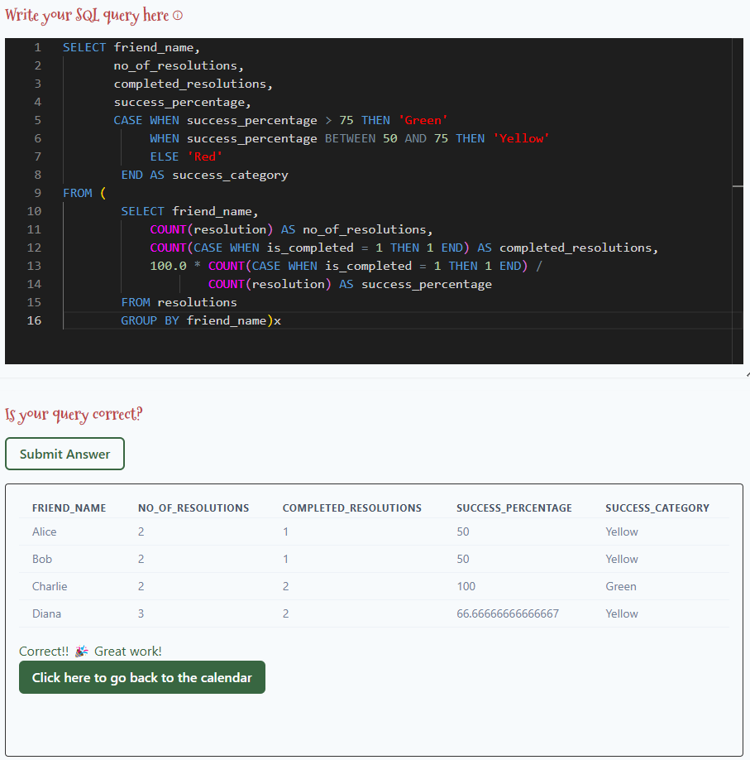
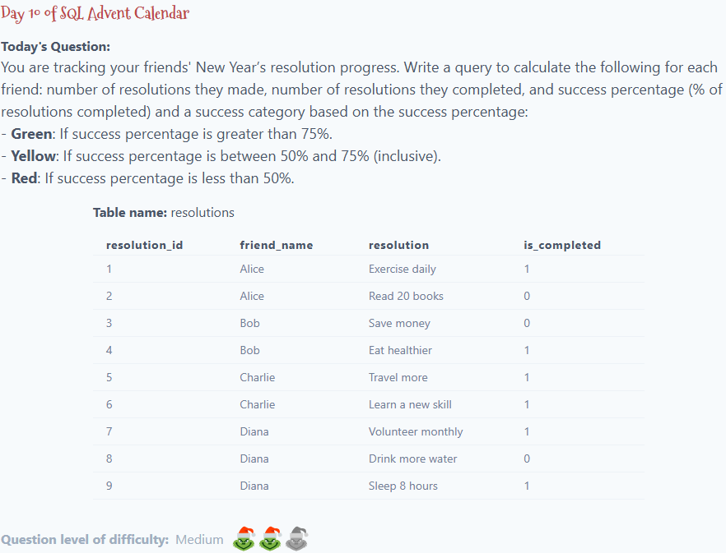

Slide 32
Solution:
SELECT friend_name,
no_of_resolutions,
completed_resolutions,
success_percentage,
CASE WHEN success_percentage > 75 THEN 'Green'
WHEN success_percentage BETWEEN 50 AND 75 THEN 'Yellow'
ELSE 'Red'
END AS success_category
FROM (
SELECT friend_name,
COUNT(resolution) AS no_of_resolutions,
COUNT(CASE WHEN is_completed = 1 THEN 1 END) AS completed_resolutions,
100.0 * COUNT(CASE WHEN is_completed = 1 THEN 1 END) /
COUNT(resolution) AS success_percentage
FROM resolutions
GROUP BY friend_name)x

Slide 33
Day 11

Slide 34
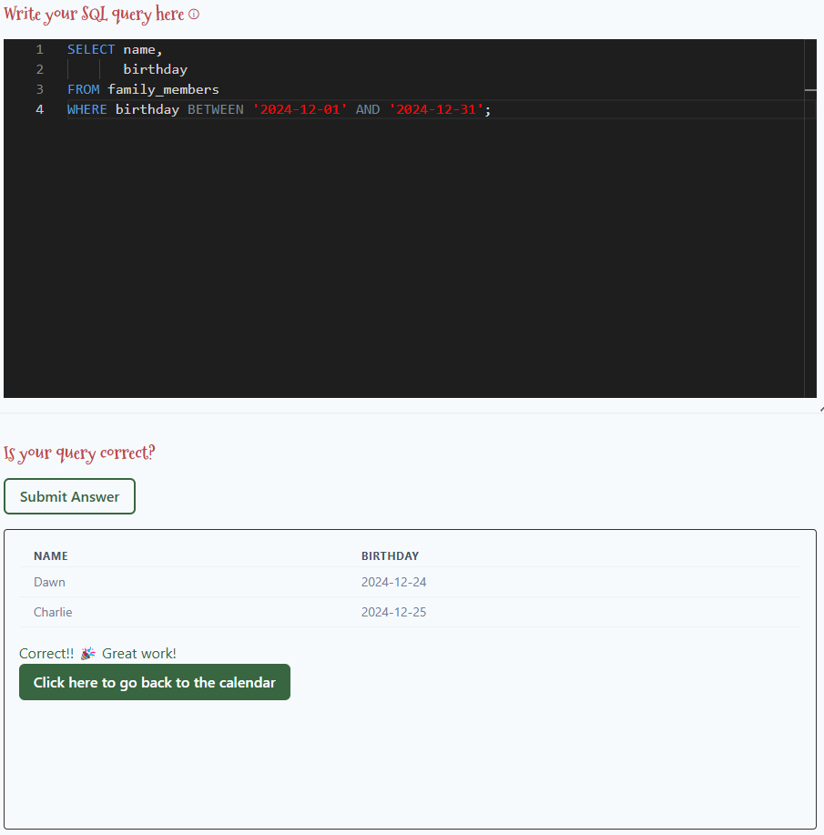
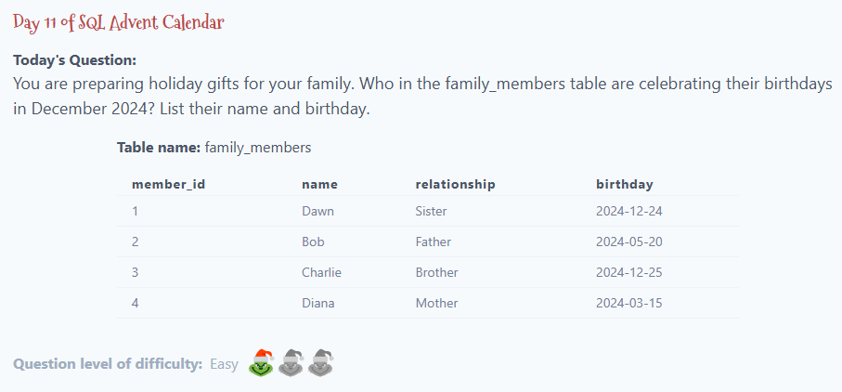

Slide 35
Solution:
SELECT name,
birthday
FROM family_members
WHERE birthday BETWEEN '2024-12-01' AND '2024-12-31';

Slide 36
Day 12

Slide 37
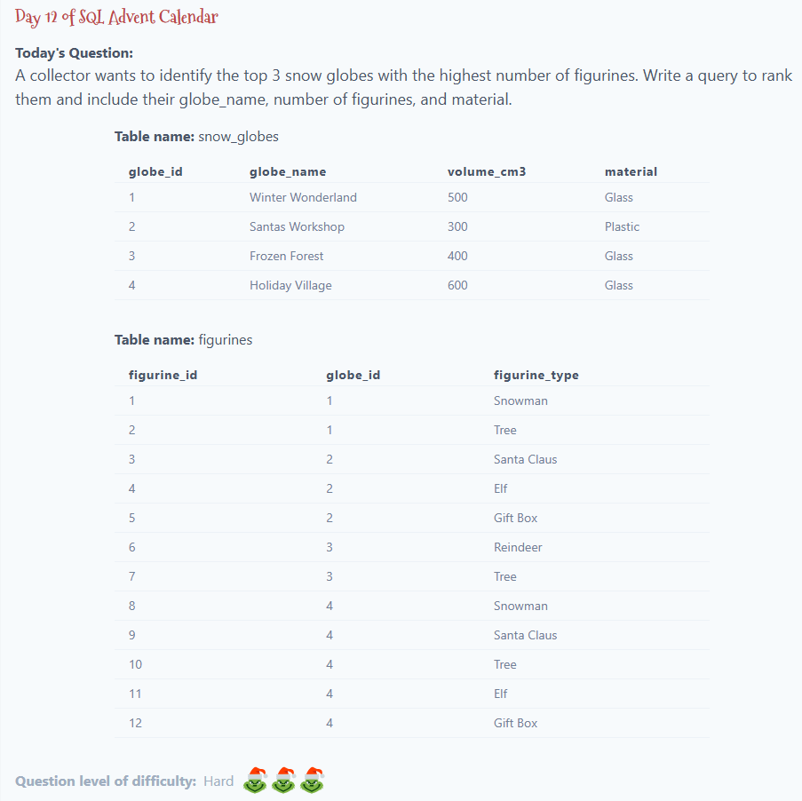
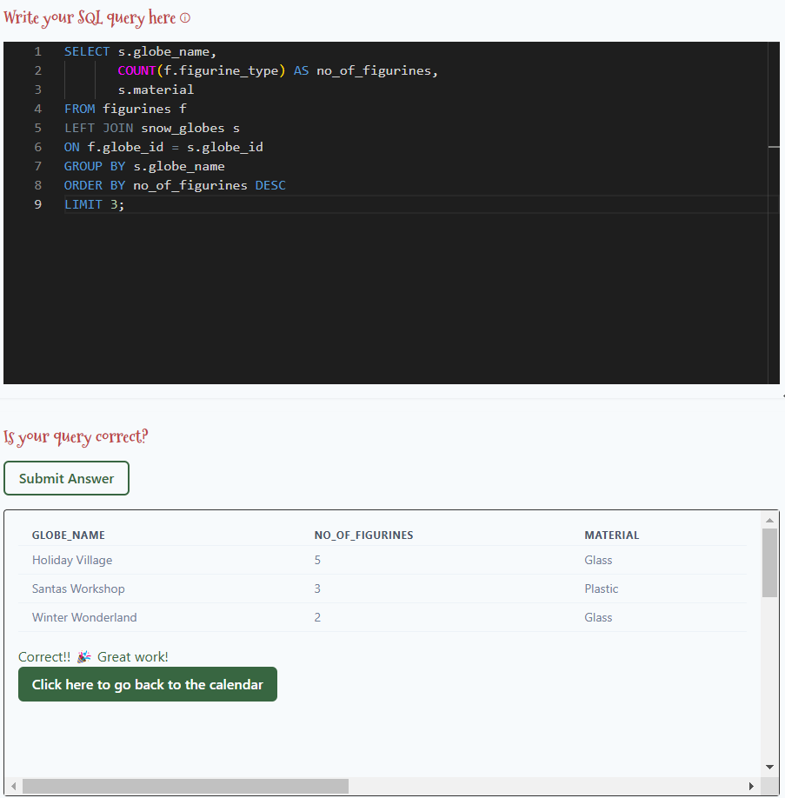

Slide 38
Solution:
SELECT s.globe_name,
COUNT(f.figurine_type) AS no_of_figurines,
s.material
FROM figurines f
LEFT JOIN snow_globes s
ON f.globe_id = s.globe_id
GROUP BY s.globe_name
ORDER BY no_of_figurines DESC
LIMIT 3;

Slide 39
Day 13

Slide 40
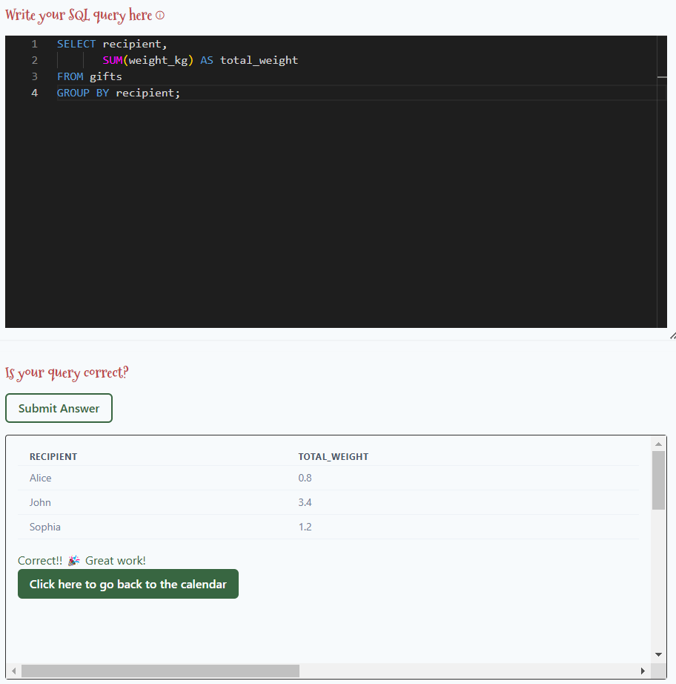
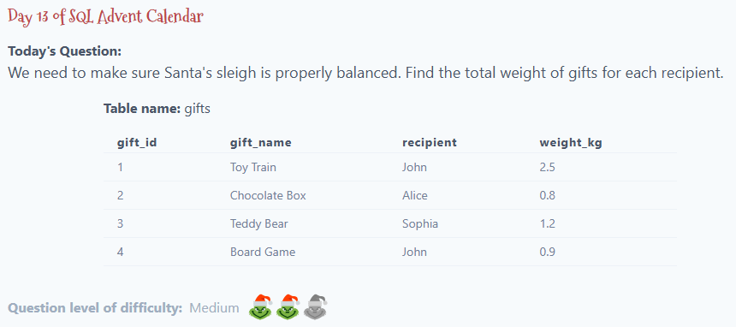

Slide 41
Solution:
SELECT recipient,
SUM(weight_kg) AS total_weight
FROM gifts
GROUP BY recipient;

Slide 42
Day 14

Slide 43
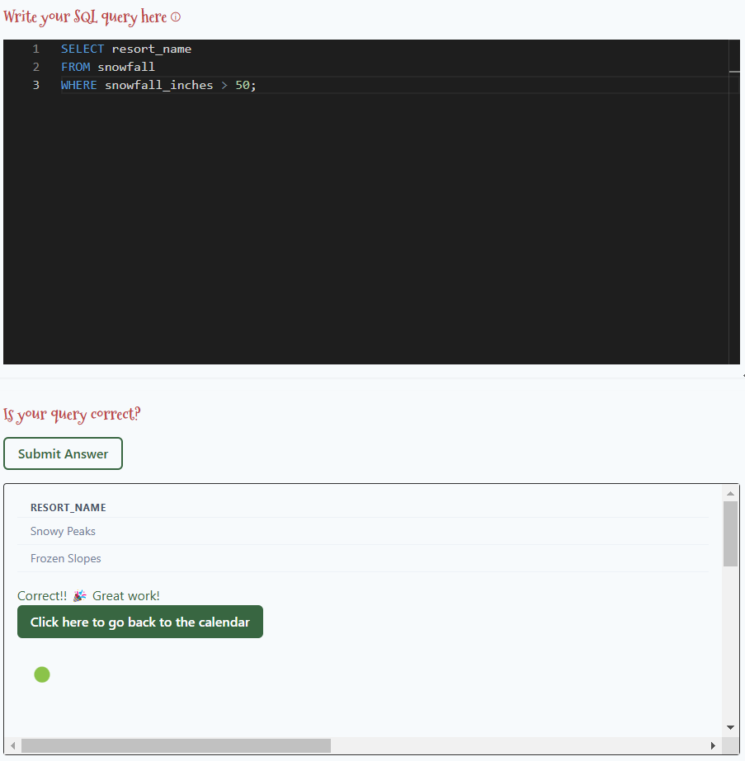
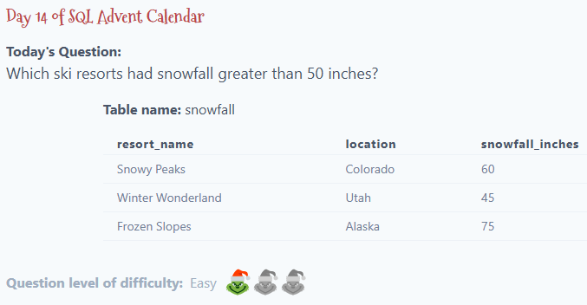

Slide 44
Solution:
SELECT resort_name
FROM snowfall
WHERE snowfall_inches > 50;

Slide 45
Day 15

Slide 46
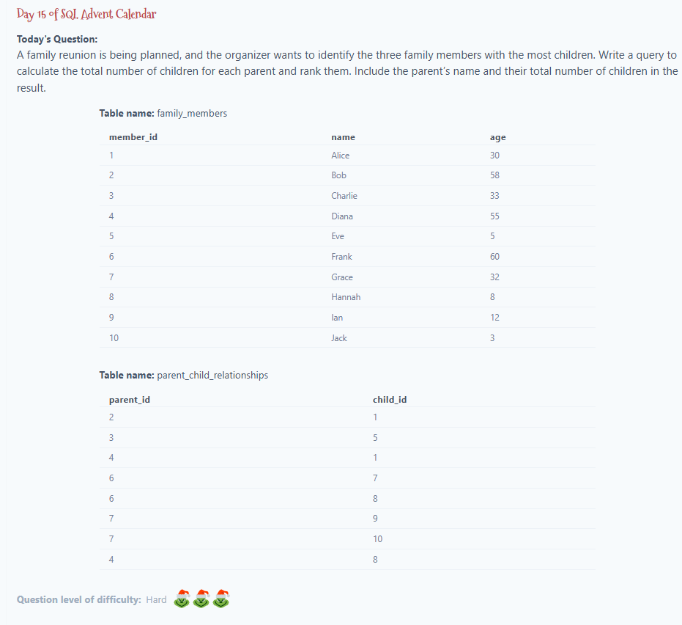
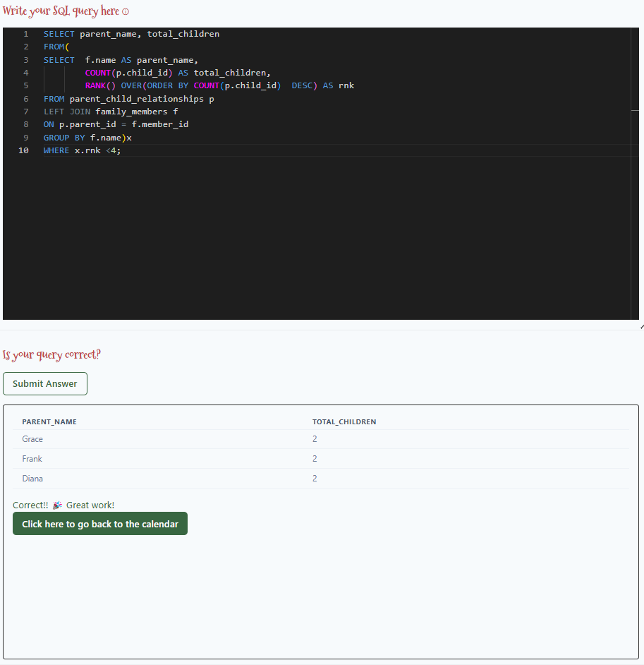

Slide 47
Solution:
SELECT parent_name, total_children
FROM(
SELECT f.name AS parent_name,
COUNT(p.child_id) AS total_children,
RANK() OVER(ORDER BY COUNT(p.child_id) DESC) AS rnk
FROM parent_child_relationships p
LEFT JOIN family_members f
ON p.parent_id = f.member_id
GROUP BY f.name)x
WHERE x.rnk <4;

Slide 48
Day 16

Slide 49
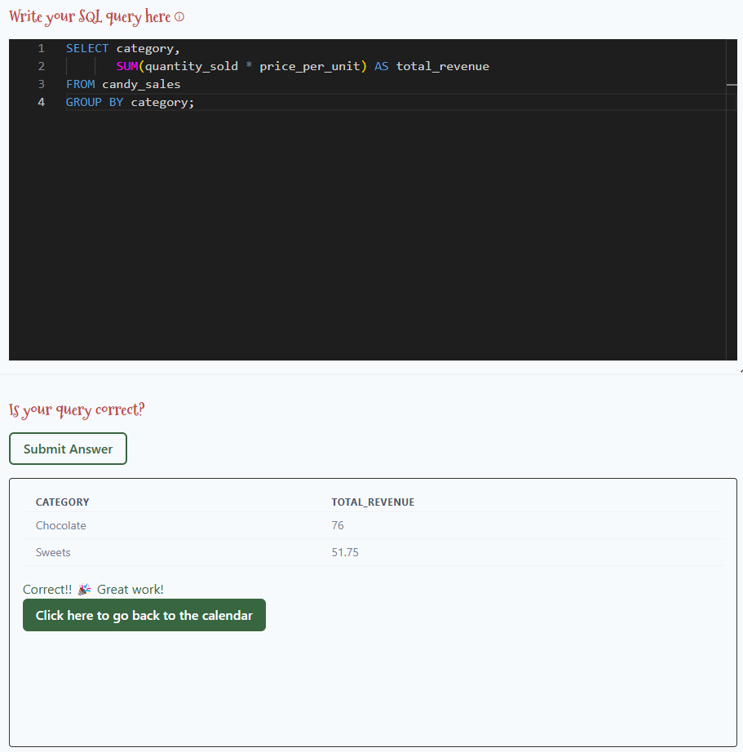
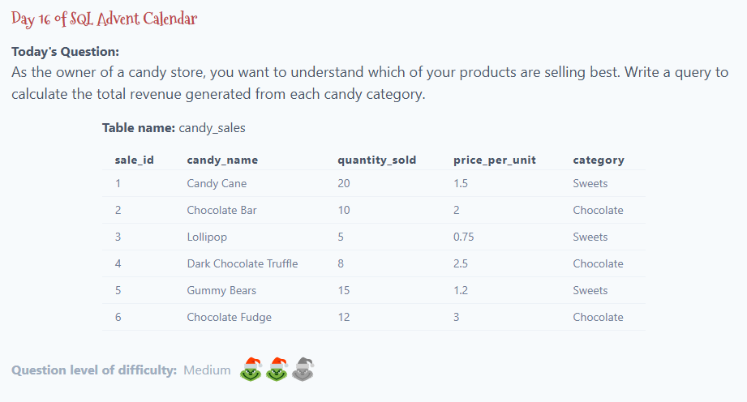

Slide 50
Solution:
SELECT category,
SUM(quantity_sold * price_per_unit) AS total_revenue
FROM candy_sales
GROUP BY category;

Slide 51
Day 17

Slide 52
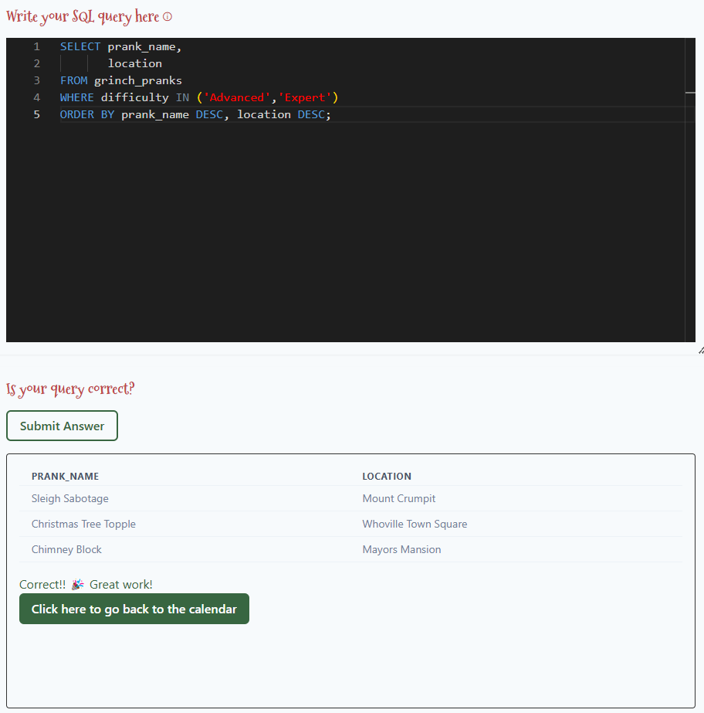
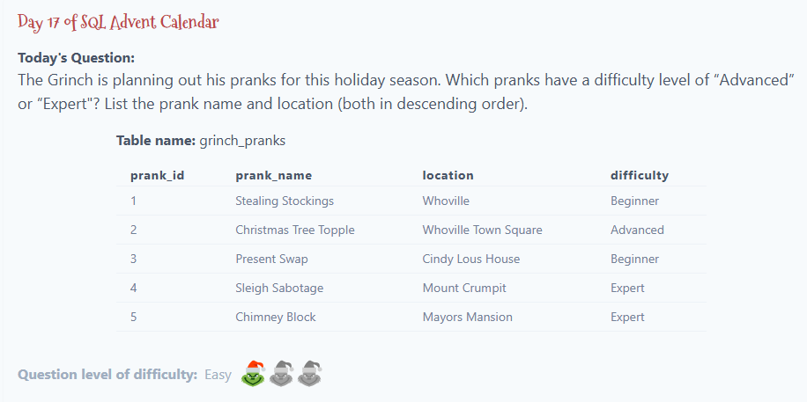

Slide 53
Solution:
SELECT prank_name,
location
FROM grinch_pranks
WHERE difficulty IN ('Advanced','Expert')
ORDER BY prank_name DESC, location DESC;

Slide 54
Day 18

Slide 55
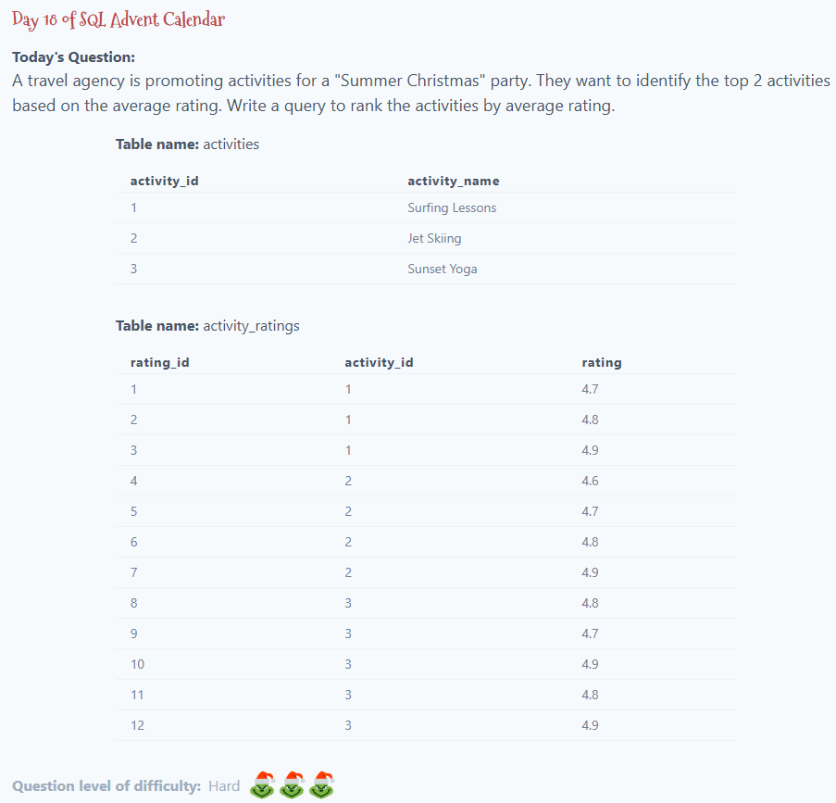
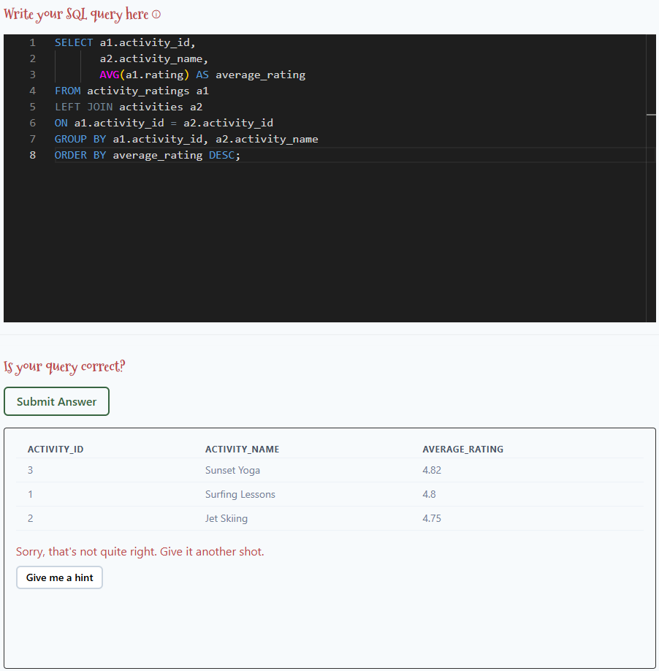

Slide 56
Solution:
SELECT a1.activity_id,
a2.activity_name,
AVG(a1.rating) AS average_rating
FROM activity_ratings a1
LEFT JOIN activities a2
ON a1.activity_id = a2.activity_id
GROUP BY a1.activity_id, a2.activity_name
ORDER BY average_rating DESC;

Slide 57
Day 19

Slide 58
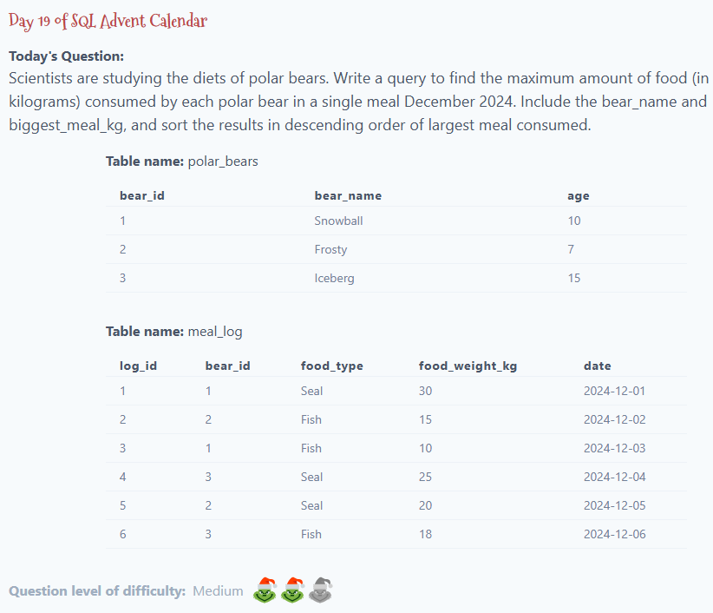
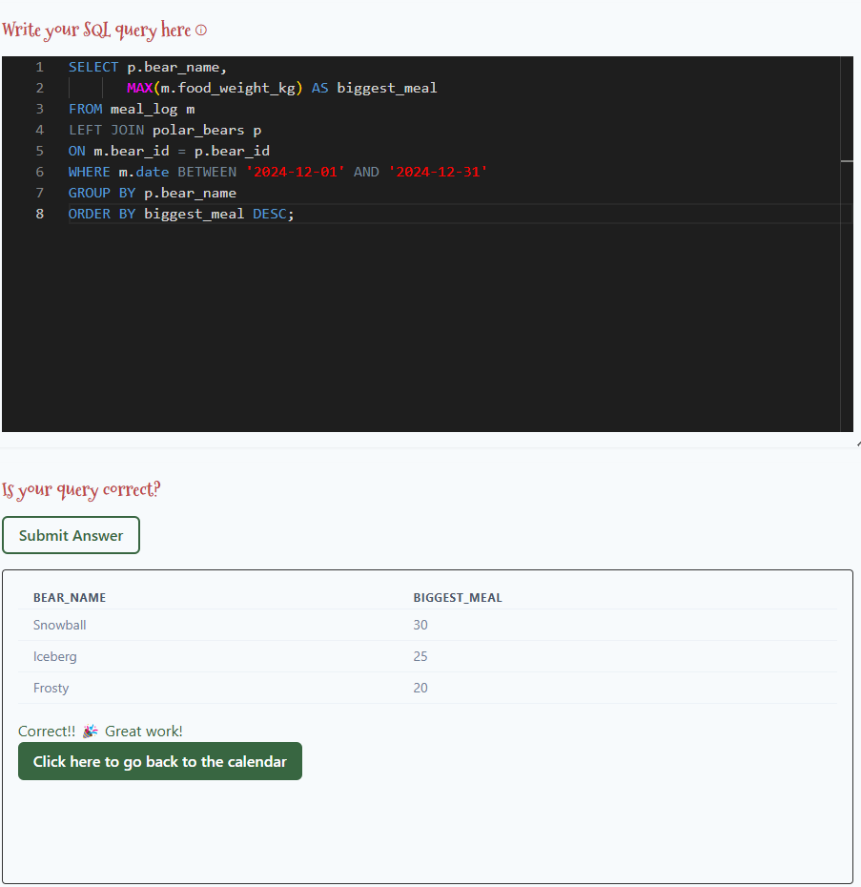

Slide 59
Solution:
SELECT p.bear_name,
MAX(m.food_weight_kg) AS biggest_meal
FROM meal_log m
LEFT JOIN polar_bears p
ON m.bear_id = p.bear_id
WHERE m.date BETWEEN '2024-12-01' AND '2024-12-31'
GROUP BY p.bear_name
ORDER BY biggest_meal DESC;

Slide 60
Day 20

Slide 61
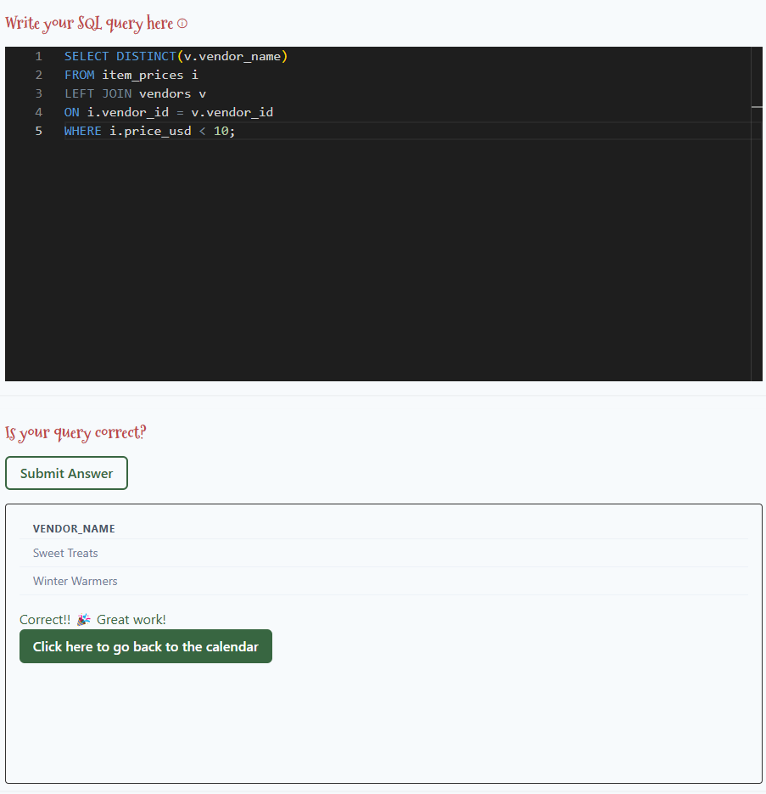
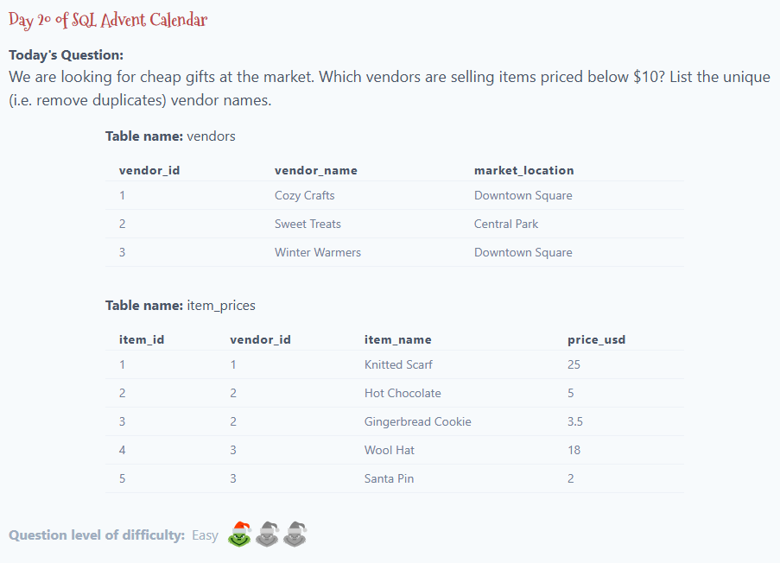

Slide 62
Solution:
SELECT DISTINCT(v.vendor_name)
FROM item_prices i
LEFT JOIN vendors v
ON i.vendor_id = v.vendor_id
WHERE i.price_usd < 10;

Slide 63
Day 21

Slide 64
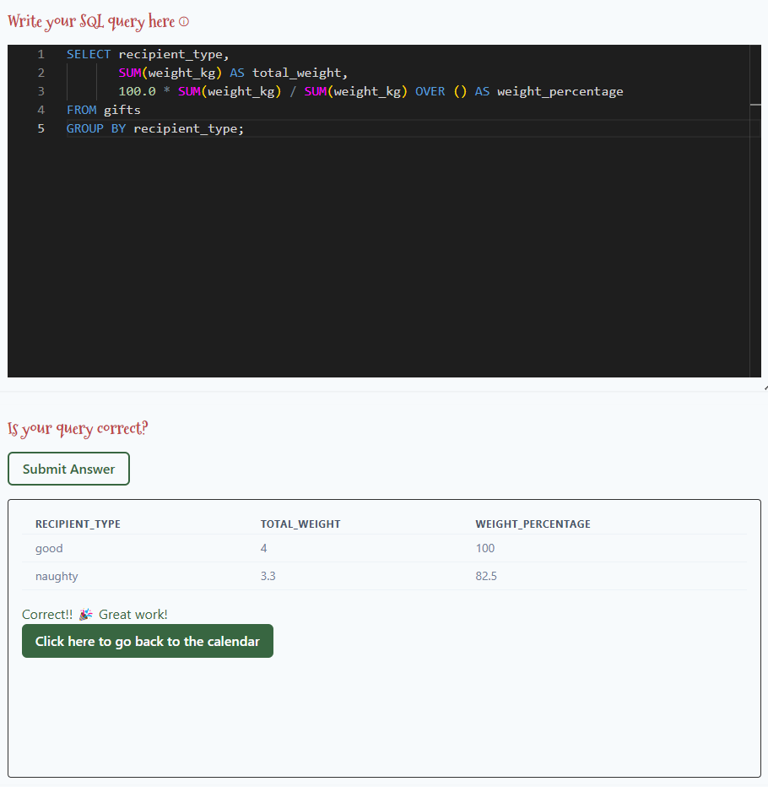
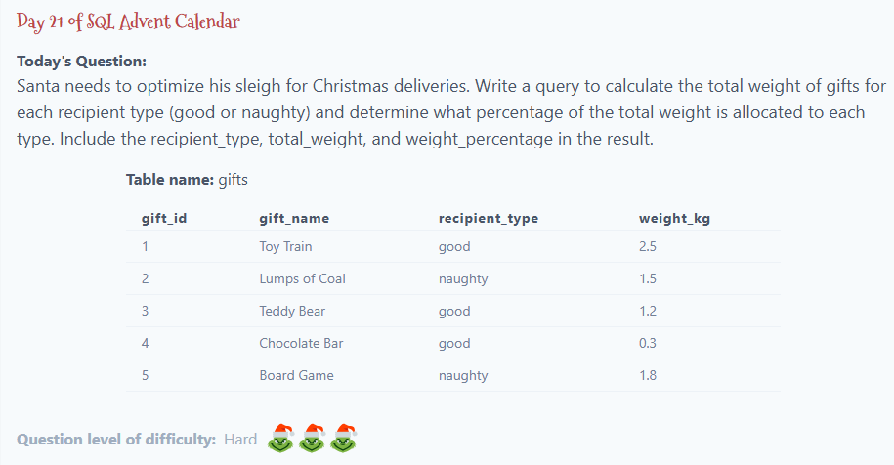

Slide 65
Solution:
SELECT recipient_type,
SUM(weight_kg) AS total_weight,
100.0 * SUM(weight_kg) / SUM(weight_kg) OVER () AS weight_percentage
FROM gifts
GROUP BY recipient_type;

Slide 66
Day 22

Slide 67
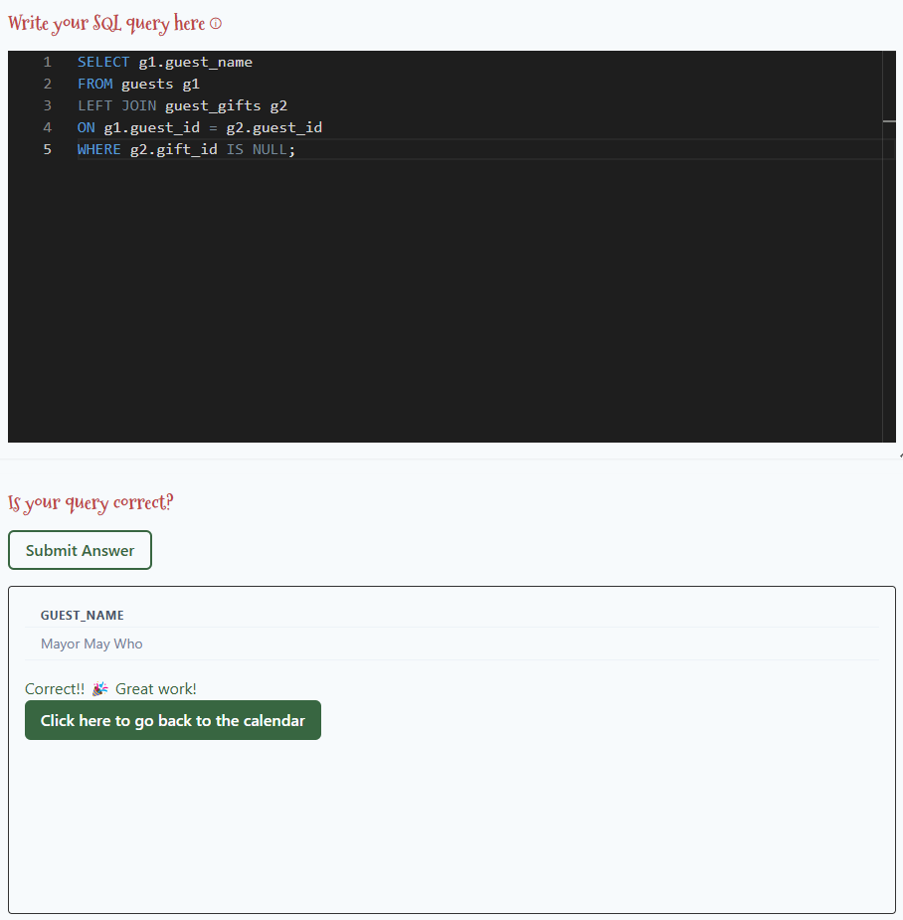
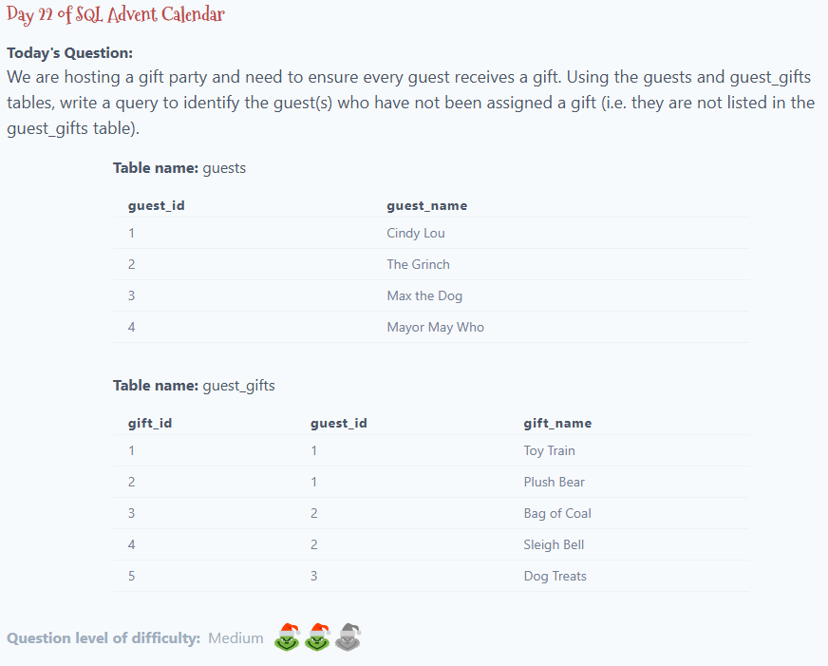

Slide 68
Solution:
SELECT g1.guest_name
FROM guests g1
LEFT JOIN guest_gifts g2
ON g1.guest_id = g2.guest_id
WHERE g2.gift_id IS NULL;

Slide 69
Day 23

Slide 70
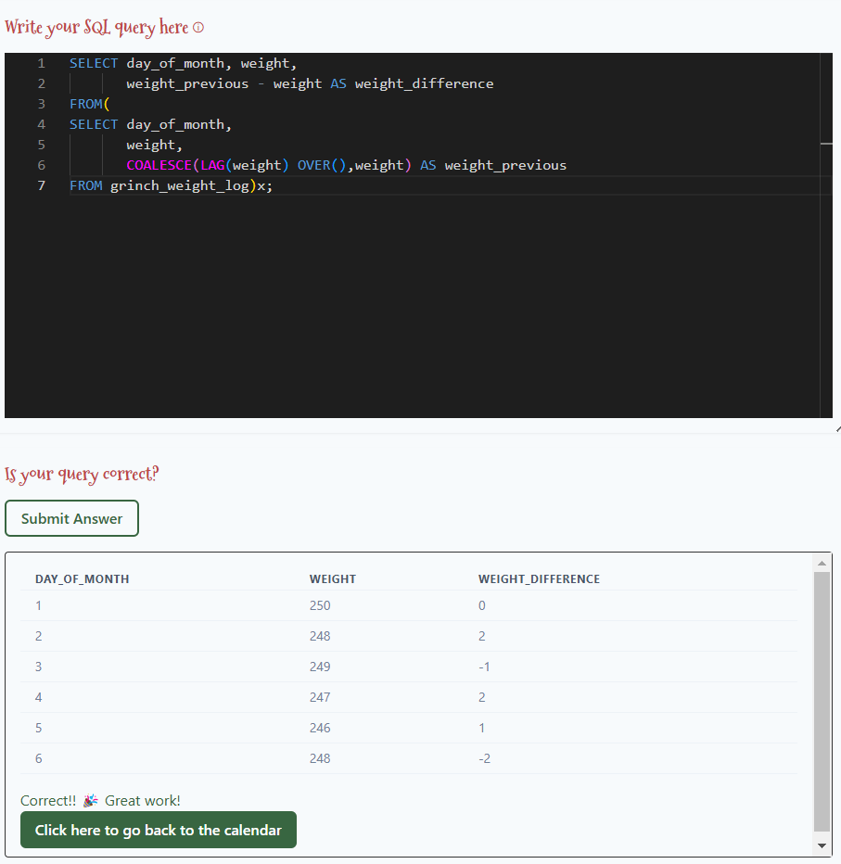
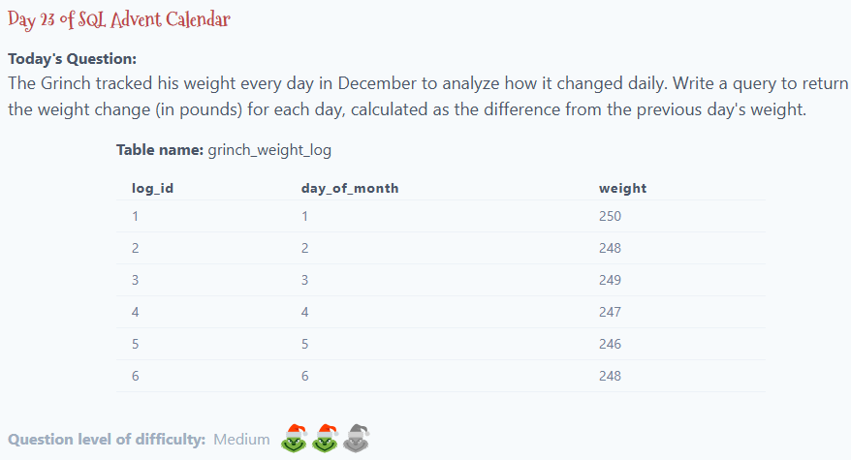

Slide 71
Solution:
SELECT day_of_month, weight,
weight_previous - weight AS weight_difference
FROM(
SELECT day_of_month,
weight,
COALESCE(LAG(weight) OVER(),weight) AS weight_previous
FROM grinch_weight_log)x;

Slide 72
Day 24

Slide 73
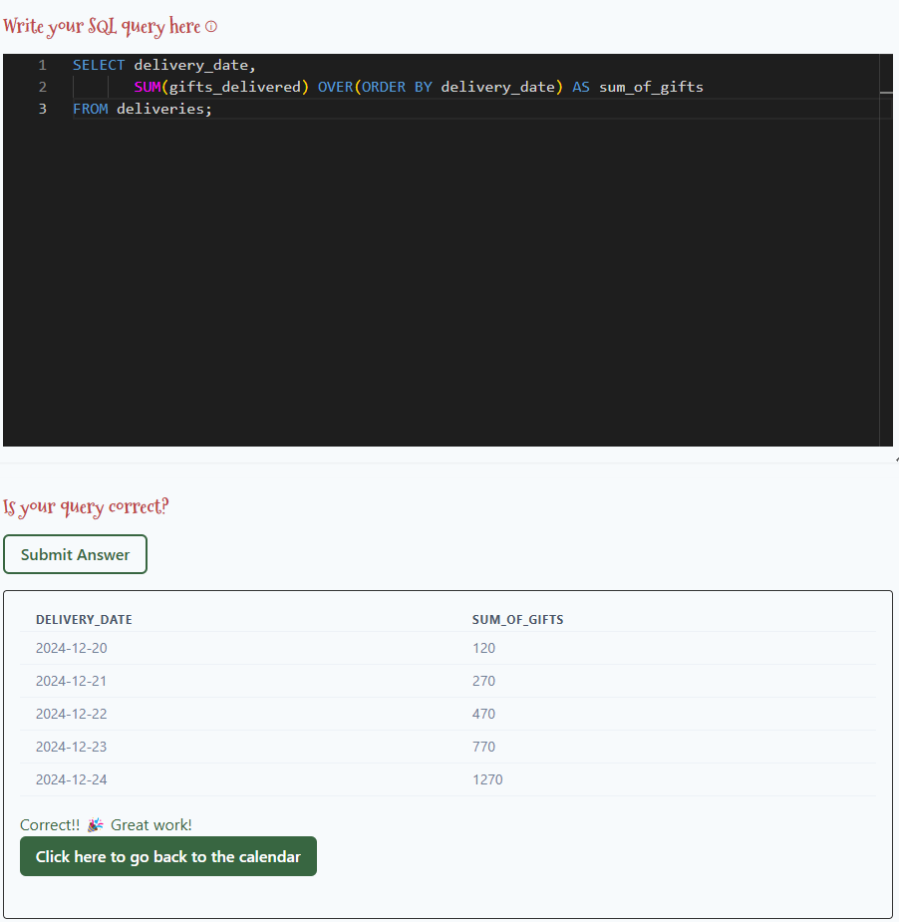
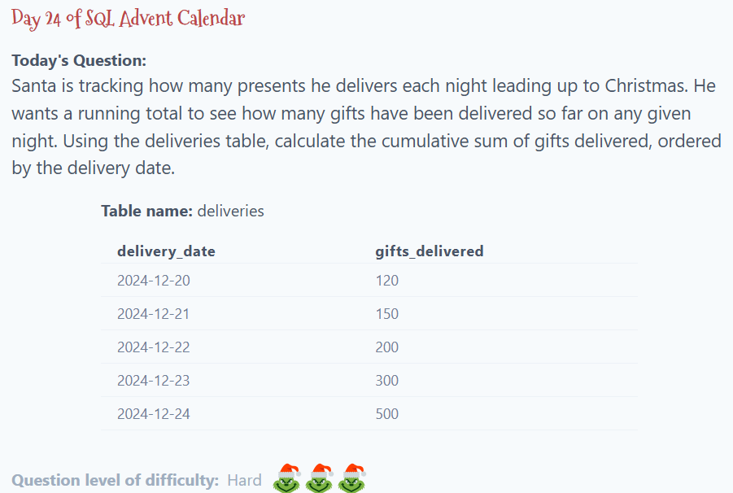

Slide 74
Solution:
SELECT delivery_date,
SUM(gifts_delivered) OVER(ORDER BY delivery_date) AS sum_of_gifts
FROM deliveries;

